Slide 1

https://youtu.be/eajEY8WbVwc

Slide 2
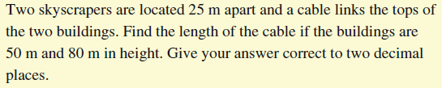
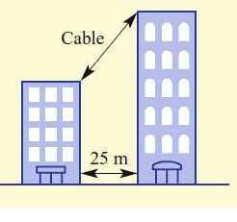
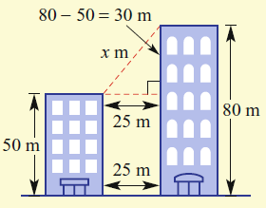
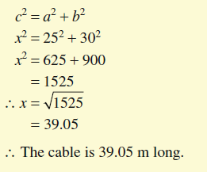
24
7
30
Topic: Pythagoras Problem Solving
Date:
EQ: How do we solve problems with Pythagoras theorem?
Step 1. If there isn’t a diagram, create one.
Step 2. Identify the right angled triangle
Step 3. Use the measurements you have to identify the lengths of any sides you can
Step 4. Solve using Pythagoras

Slide 3
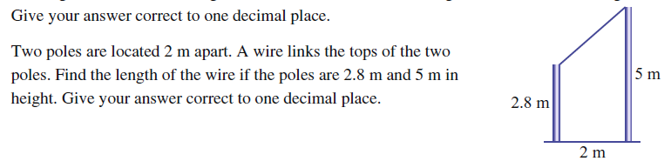

Slide 4
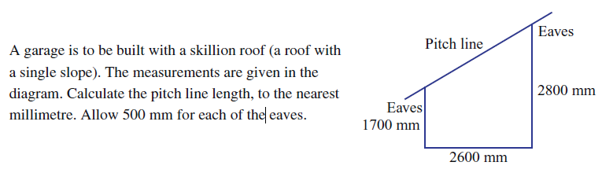
Let’s Try

Slide 5
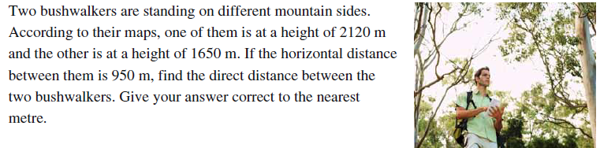
Let’s Try

Slide 6
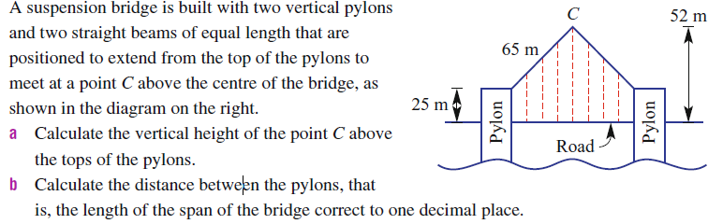

Slide 7
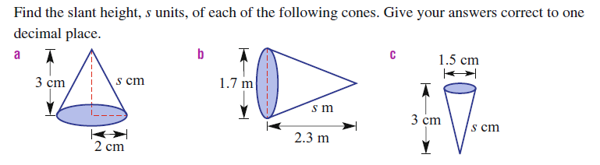

Slide 8
